Slide 1
Similarity Measures for Text Document Clustering
Anna Huang
Department of Computer Science
The University of Waikato, Hamilton, New Zealand
BY Farah Kamw

Slide 2
1.INTRODUCTION
Clustering is a useful technique that organizes a large quantity of unordered text documents into a small number of meaningful and coherent cluster.
A wide variety of distance functions and similarity measures have been used for clustering, such as squared Euclidean distance, and cosine similarity.
Text document clustering groups similar documents to form a coherent cluster, while documents that are diﬀerent have separated apart into diﬀerent clusters.

Slide 3
1.INTRODUCTION (cont.)
In this paper, they compare and analyze the eﬀectiveness of these measures in partitional clustering for text document datasets. their experiments utilize the standard K-means algorithm and they report results on seven text document datasets and ﬁve distance/similarity measures that have been most commonly used in text clustering.
They use two measures to evaluate the overall quality of clustering solutions—purity and entropy, which are commonly used in clustering.

Slide 4
2.DOCUMENT REPRESENTATION
They use the frequency of each term as its weight, which means terms that appear more frequently are more important and descriptive for the document.
Let D = { d₁, . . . , d_{n} } be a set of documents and
T = {t₁, . . . ,t_{m} } the set of distinct terms occurring
in D. A document is then represented as a m-
dimensional vector t_{d}.
Let tf(d, t) denote the frequency of term t ∈ T in document d ∈ D. Then the vector representation of a document d is

Slide 5
2.DOCUMENT REPRESENTATION (cont.)
Terms are basically words. But they applied several standard transformations on the basic term vector representation.
First, the stop words are removed. There are words that are non-descriptive for the topic of a document, such as a, and, are and do. They used learning workbench, which contains 527 stop words.
Second, words were stemmed using Porter’s suﬃx-stripping algorithm, so that words with diﬀerent endings will be mapped into a single word. For example production, produce, produces and product will be mapped to the stem produce.

Slide 6

2.DOCUMENT REPRESENTATION (cont.)
Third, the words that appear with less than a given threshold frequency were discarded.
Consequently, they select the top 2000 words ranked by their weights and use them in their experiments.
In addition , the terms that appear frequently in a small number of documents but rarely in the other documents tend to be more important, and therefore more useful for ﬁnding similar documents. So, they
transform the basic term frequencies tf(d, t) into the
tfidf.
Notes:
(term frequency and inversed document frequency), Here df(t) is the number of documents in which term t appears.

Slide 7
3.SIMILARITY MEASURES
In general, similarity/distance measures map the distance or similarity between the symbolic description of two objects into a single numeric value, which depends on two factors— the properties of the two objects and the measure itself.

Slide 8
3.1 Metric
To qualify as a metric, a measure d must satisfy the following four conditions.
Let x and y be any two objects in a set and d(x, y) be the distance between x and y.
1. d(x, y) >= 0.
2. d(x, y) = 0 if and only if x = y.
3. d(x, y) = d(y, x).
4. d(x, z) = d(x, y) + d(y, z).
Notes:
1.The distance between any two points must be nonnegative
2.The distance between two objects must be zero if and only if the two objects are identical, that is,
3. Distance must be symmetric, that is, distance from x to y is the same as the distance from y to x.
4. The measure must satisfy the triangle inequality,which is

Slide 9

3.2 Euclidean Distance
Euclidean distance is widely used in clustering problems, including clustering text. It satisﬁes all the above four conditions and therefore is a true metric.
Measuring distance between text documents, given two documents d_{a} and d_{b} represented by their term vectors t_{a} and t_{b} respectively, the Euclidean distance of the two documents is deﬁned as:

Slide 10

3.3 Cosine Similarity
When documents are represented as term vectors, the similarity of two documents corresponds to the correlation between the vectors. This is quantiﬁed as the cosine of the angle between vectors.
Where t_{a} and t_{b} are m-dimensional vectors over the term set T = {t₁,…,t_{m} }. Each dimension represents a term with its weight in the document, which is non-negative. As a result, the cosine similarity is non-negative and bounded between [0,1].

Slide 11

3.4 Jaccard Coeficient
Measures similarity as the intersection divided by the union of the objects.
The formal deﬁnition is:
The Jaccard coeﬃcient is a similarity measure and ranges between 0 and 1, where 1 means the two objects are the same and 0 means they are completely diﬀerent. The corresponding distance measure is D_{J}= 1 - SIM_{J}

Slide 12

3.5 Pearson Correlation Coefﬁcient
Given the term set T={t₁,…,t_{m}}a commonly used form is:
This is also a similarity measure. However, unlike the other measures, it ranges from +1 to -1 and it is 1 when t_{a}=t_{b} .
D_{p}=1-sim_{p} when sim_{p}>=0,and D_{p}=sim_{p} if sim_{p}<0.
Notes:
In subsequent experiments they use the corresponding distance measure,

Slide 13
3.6 Averaged KL Divergence
In information theory based clustering, a document is considered as a probability distribution of terms. The similarity of two documents is measured as the distance between the two corresponding probability distributions.
The entropy divergence (KL divergence), is a widely applied measure for evaluating the differences between two probability distributions.

Slide 14
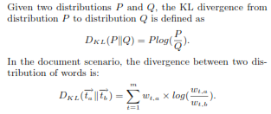

Slide 15
4. K-Mean Clustering Algorithm
This is an iterative partitional clustering process that aims to minimize the least squares error criterion.
The K-means algorithm works as follows.
Given a set of data objects D and a pre-speciﬁed number of clusters k,
k data objects are randomly selected to initialize k clusters, each one being the centroid of a cluster.
The remaining objects are then assigned to the cluster represented by the nearest or most similar centroid.
A new centroids are re-computed for each cluster and in turn all documents are re-assigned based on the new centroids. This step iterates until all data objects remain in the same cluster after an update of centroids.

Slide 16
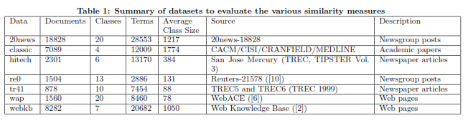
5.Experment
5.1 Datasets
Notes:
These datasets diﬀer in terms of document type, number of categories, average category size, and subjects. In order to ensure diversity, the datasets are from diﬀerent sources, some containing newspaper articles, some containing newsgroup posts, some being web pages and the remaining being academic papers.

Slide 17

5.2 Evaluation
The quality of a clustering result was evaluated using two evaluation measures—purity and entropy.
The purity measure evaluates the coherence of a cluster, that is, the degree to which a cluster contains documents from a single category.
Given a particular cluster C_{i} of size n_{i} ,The purity of C_{i}
is formally deﬁned as:
In general, the higher the purity value, the better the quality of the cluster is.
Notes:
For each of the above datasets, we obtained a clustering result from the K-means algorithm. The number of clusters is set as the same with the number of pre-assigned categories in the data set.
222. the dominant category in cluster C
i
and n
h
i
represents the
number of documents from cluster C_{I} assigned to category h.
333. For an ideal cluster, which only contains documents from a
single category, its purity value is 1.

Slide 18
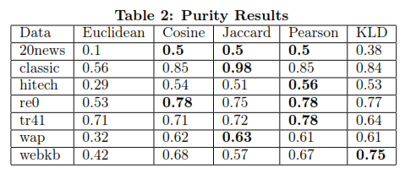

Slide 19

5.2 Evaluation (cont.)
The entropy measure evaluates the distribution of categories in a given cluster.
The entropy of a cluster C_{i} with size n_{i} is deﬁned as:
For an ideal cluster with documents from only a single category, the entropy of the cluster will be 0.
In general, the smaller the entropy value, the better the quality of the cluster is.
Notes:
where c is the total number of categories in the data set

Slide 20
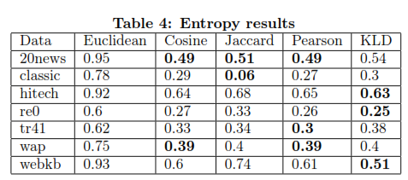

Slide 21
Thank You

